Slide 1
Digital Portfolio

Slide 2
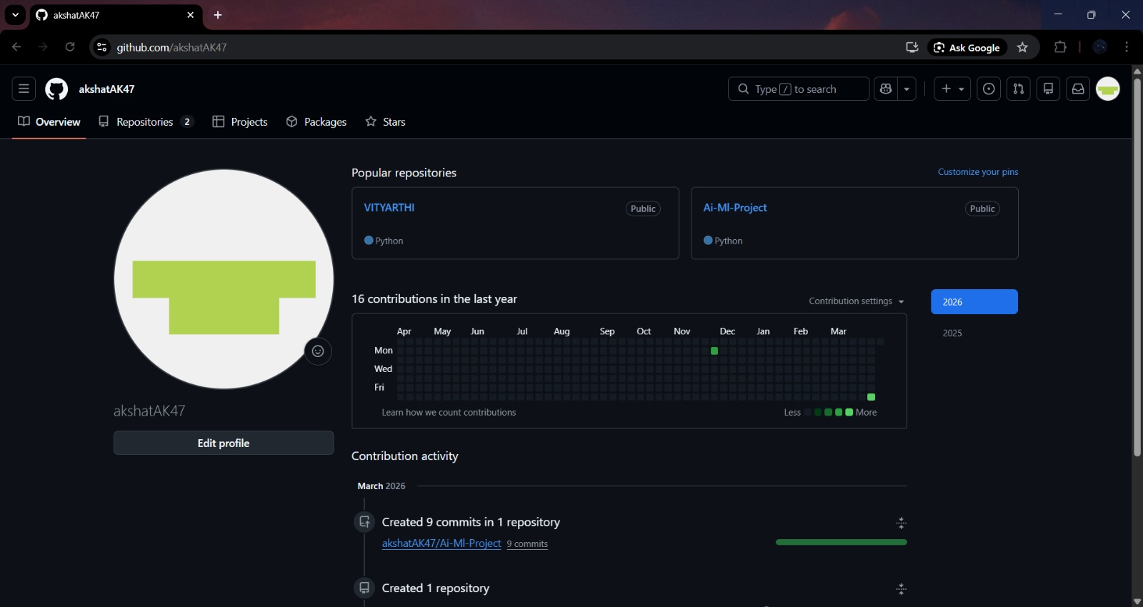
- Create accounts on at least 3 platforms: GitHub

Slide 3
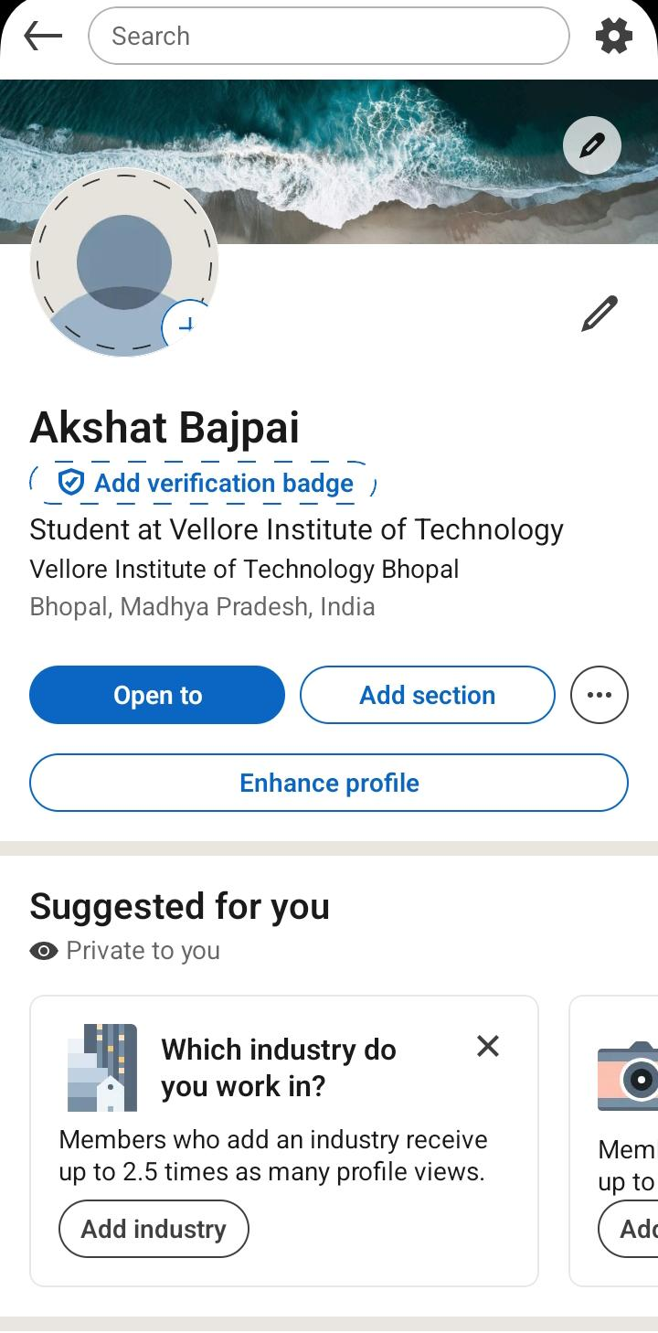
LinkedIn

Slide 4
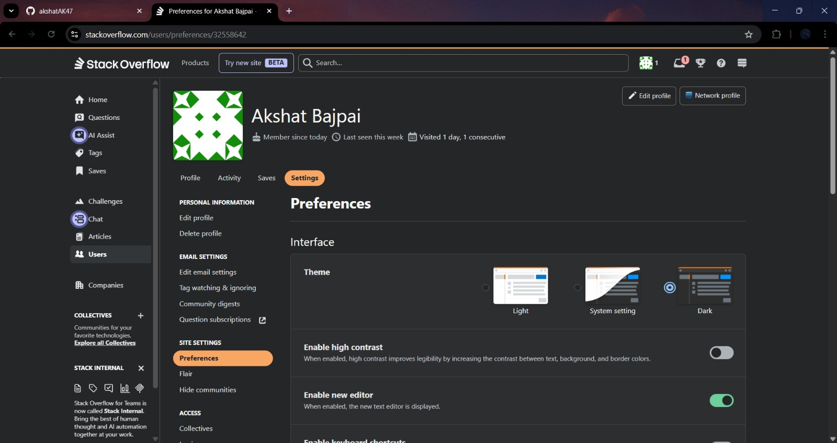
Stack Overflow

Slide 5
For my digital portfolio, I have chosen to join three key platforms: GitHub, LinkedIn, and Stack Overflow. These platforms have different roles to play in developing my digital presence and helping me enhance my digital skills.
GitHub is primarily a platform to showcase my projects, upload code, and monitor my progress in developing programming skills. This platform will help me build a robust portfolio that I can share with others. LinkedIn is primarily a platform to build a professional profile, where I can highlight my academic achievements, skills, and success. I will also be able to build a network of professionals and explore various career options. Stack Overflow is a platform that will help me enhance my knowledge by providing solutions to coding-related problems and explaining various programming concepts to me.
My primary objective of using these platforms is to enhance my knowledge, build my professional identity, and stay connected to the digital community. I plan to use these platforms in the future to enhance my knowledge, build a professional network, and contribute to the digital community.

